Slide 1
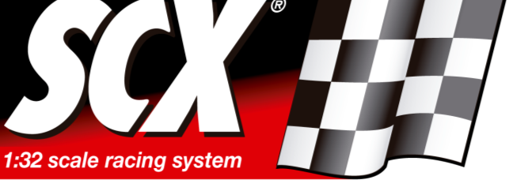
2.4G Wireless Overtaking System Product launch November 2014
SCX WOS

Slide 2
New SCX technology in 2014.
Wireless hand controller for each car, based on 2.4 Ghz RADIOFREQUENCY.
Hand controllers with rechargeable batteries.
Basic features will be the same than in SCX Digital:
Up to 6 players/cars on the same racetrack.
Lane changing / overtaking.
Communication of cars when passing the start/finish line and communication of future WOS accessories will also be wireless.

Slide 3
Additional new functions / characteristics:
Hand controllers with sound.
Cars with rear braking lights.
Level-indicating LED lights on the upper part of the hand controllers.
Synchronization of hand controller and car, at an individual car level, performed from each controller.
Cars equipped with a switch, which allows them to be used in analog tracks.
SCX Digital Sytem accessories which ARE compatible with WOS: regular tracks, supersliding curve, grand chicane, straight and curve lane change tracks, left- and right-hand drive-in tracks.

Slide 4
Digital System accessories which ARE NOT compatible with WOS:
Essentially we are speaking about everything which is electronic:
Control Unit, Lap Counter, Chronometer, Pit Box and their corresponding extension modules.
Hand Controllers
Digitalization Kits
Transformers
Connection tracks and cables
Guides

Slide 5
SCX UNIVERSAL ACCESSORIES:
From 2015 on, they will not have Power Line, as the new WOS does not need it.
Universal accessories from 2014 and former years are compatible with both WOS and SCX Digital System.
2015 Universal Accessories will be compatible with WOS, but not with SCX Digital System.
Universal Accessories WITHOUT Power Line from 2015 on: all srots of trakcs, including the Universal Bridge with light, the Banked Curve and the Universal Supersliding Curve.

Slide 6
WOS incompatible with Digital System in most aspects.
WOS has its own hand controllers, cars and accessories.
Universal Accessories WITHOUT Power Line, from 2015 on, will be compatible with WOS, but not with such SCX Digital System accessories as Pit Box, Chronometer, Lap Counter…
This is why:
We have changed the name of the new system to WOS, taking care to get rid of any reference to Digital.
WOS will have its own item coding:
All items will begin with W…
The remaining part of the item number will follow the same coding system as all other SCX items.

Slide 7
SCX WOS
2014
SETS

Slide 8
FUNCTION | DIGITAL REVOLUTION | PILOT-FULL CONTROL
Lane changing / overtaking | ✓ | ✓
Wireless rechargeable hand controllers | ✓ | ✓
Hand controllers with LED lights |  | ✓
Programming of car braking |  | ✓
Programming of car speed limit |  | ✓
Car lights controlled from hand controller | ✓ | ✓
Sound in Hand Controller | ✓ | ✓
Up to 6 players/cars on the racetrack | ✓ | ✓
Ghost Car |  | ✓
Pace Car |  | ✓
Racestart lights in the central unit |  | ✓
Race start control |  | ✓
Race Finish Control |  | ✓
Cars can be switched to analogue | ✓ | ✓
Cars with braking lights | ✓ | ✓

Slide 9
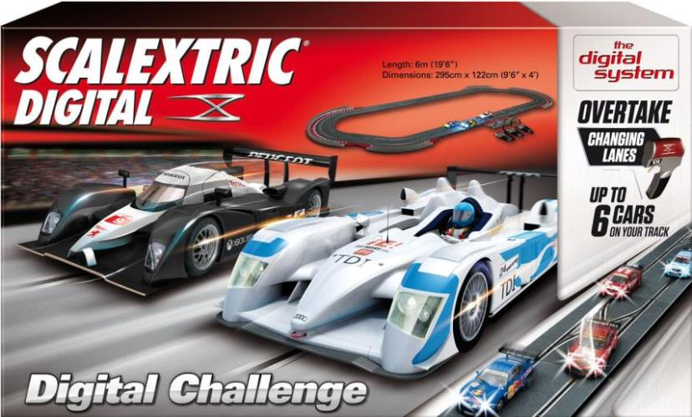
Attention: Packaging to be reworked with WOS branding
WOS System
Set 1:32
RACE REVOLUTION
W10134X500

Slide 10
Same function as the former basic SCX Digital set.
Plus ADDITIONAL FUNCTIONS / IMPROVEMENTS:
Wireless hand throttles with rechargeable batteries.
Real car sound in each hand throttle.
Individual car lights switched on/off in the hand controller of the corresponding car.
Cars with braking lights.
Individual programming / synchronization of every car with its corresponding hand controller.
Switch in the cars which allows them to be used both in WOS and analogue racetracks.
WOS System
Set 1:32
RACE REVOLUTION
W10134X500

Slide 11
SET COMPOSITION:
6 standard straights.
8 standard curves.
2 double lane change straights.
1 connection track.
1 standard straight with painted numbers 3-6.
8 standard red fences (without borders).
WITHOUT power line.
2 cars with lights (and simplified liveries): BMW M3 GT2 «Crowne Plaza» and Corvette C6R GT Open.
2 WOS basic hand controllers.
1 transformer.
WOS System
Set 1:32
RACE REVOLUTION
W10134X500

Slide 12
Attention: Packaging to be reworked with WOS branding
Digital System
Set 1:32
PILOT-FULL CONTROL
WxxxxxS500

Slide 13
ADDITIONAL FUNCTIONS:
Hand throttles with level-indicating LED lights.
Programming of car braking intensity for individual cars.
Programming of maximum speed for individual cars.
Ghost car function.
Pace car function.
Race start lights in the central unit.
Race start control in the central unit.
Race finish control in the central unit.
WOS System
Set 1:32
PILOT-FULL CONTROL
W10135X500

Slide 14
SET COMPOSITION:
7 standard straights.
8 standard curves.
3 lane-change straights.
1 connection straight.
1 standard straight painted 3-6.
8 Barriers+Borders for standard curve.
4 Barriers+Borders right closing.
4 Barriers+Borders left closing.
WITHOUT power line.
2 cars with lights (and simplified liveries): Mercedes SLS and Aston Martin DBR9.
2 WOS advanced hand controllers.
1 transformer.
WOS System
Set 1:32
PILOT-FULL CONTROL
W10135X500

Slide 15
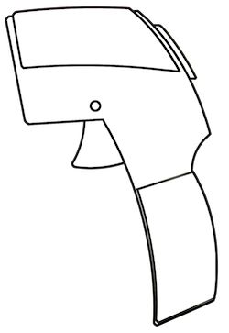
WIRELESS HAND CONTROLLERS
Wireless hand controllers.
2.4Ghz RADIOFREQUENCY technology.
Working with rechargeable batteries.

Slide 16
UP TO 6 PLAYERS/CARS
LANE CHANGING / OVERTAKING
Up to 6 cars competing at the same time on the same racetrack.
Lane change / overtaking (3 chances per lap).
6
X

Slide 17
CAR SOUND IN HAND THROTTLE
Reproducing the sound of the car engine.
If you keep button “C” pushed down, the car does not move, but the accelerating sound is reproduced. More playing value, as players can “provoke” each other just before the race starts.
You can choose to keep the motor silent.
C

Slide 18
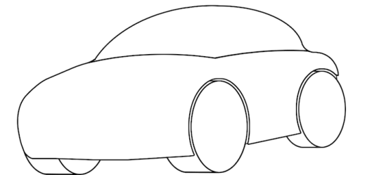
INDIVIDUAL CAR LIGHTS
C
The front lights of each individual car can be independently switched on/off, by using button “C” on the corresponding hand throttle.

Slide 19
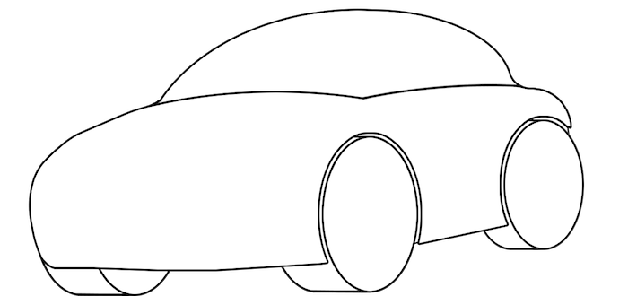
BRAKE LIGHTS
Cars have brake lights.
Brake lights will be gradually more intense as the car is stopping down.
Braking is activated when the player gradually releases the trigger.

Slide 20
SWITCH TO ANALOGUE
Cars will be fitted with a switch, which will allow you to switch to the original/analogue mode.
In analogue mode, cars will be compatible with other brand race tracks.
0
I
0

Slide 21
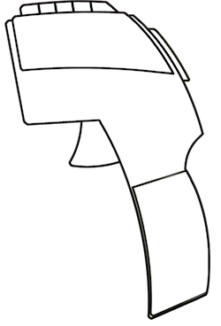
HAND THROTTLE LED LIGHTS
Only in the PILOT-FULL CONTROL set (A10135X500).
LED lights will show different colors according to the parameter which is being adjusted (speed, braking).
Used to indicate levels for each characteristic being adjusted.
A
B
C

Slide 22
PROGRAMMING OF BRAKING
5 levels of braking strength.
The higher the braking level, the lesser the inertia of the car until stopping or reducing speed.
LED lights are used to set the desired level of braking.
A
B
C

Slide 23
PROGRAMMING OF SPEED
5 speed levels.
It is used to adjust the maximum speed of the linked car.
LED lights are used to set the desired maximum speed.
A
B
C

Slide 24
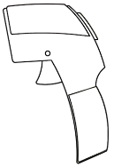
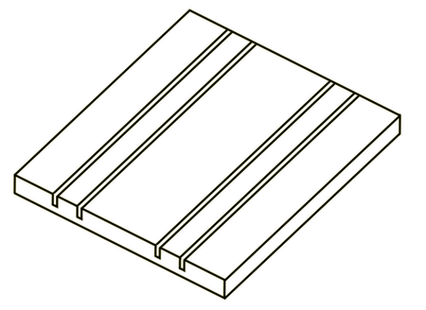
GHOST CAR
1
1
2
2
3
GHOST CAR
One of the cars can be controlled by the central unit.
The central unit will “copy” the last lap of one of the cars, and then make some adjustments in order to tune difficulty.
The central unit will detect an unsynchronized car and drive it under its control. You will just need to specify if it will be in the Ghost Car or Pace Car mode.

Slide 25
PACE CAR
1
1
2
2
3
PACE CAR
One of the cars can be controlled by the central unit.
The central unit will run the pace car at a safe and constant speed. This car will become a sort of nuisance for other players.
The central unit will detect an unsynchronized car and drive it under its control. You will just need to specify if it will be in the Ghost Car or Pace Car mode.

Slide 26
RACE START LIGHTS
1.
2.
3.
4.
START
It shows the countdown to start the race.

Slide 27
RACE START CONTROL
1.
2.
3.
4.
START
If one of the players does a false start, the central unit will reset the race and the race start lights.

Slide 28
RACE FINISH CONTROL
Start
Mid-race
About to end
Finished
FLASHES
LED lights in the central unit show how the race progresses towards the end.
When the race is over, LED lights start blinking, and so do the lights of the winner, while all cars run at a slow, constant speed.

